Slide 1

Conditionals and Value Deﬁnitions
August 31, 2012

Slide 2
Conditional Expressions
To express choosing between two alternatives, Scala has a
conditional expression if-else.
It looks like a if-else in Java, but is used for expressions, not
statements.
Example:
def abs(x: Int) = if (x >= 0) x else -x
x >= 0 is a predicate, of type Boolean.

Slide 3
Boolean Expressions
Boolean expressions b can be composed of
true
!b
b && b
b || b
false
//
//
//
//
Constants
Negation
Conjunction
Disjunction
and of the usual comparison operations:
e <= e, e >= e, e < e, e > e, e == e, e != e

Slide 4
Rewrite rules for Booleans
Here are reduction rules for Boolean expressions (e is an arbitrary
expression):
!true
!false
true && e
false && e
true || e
false || e
-->
-->
-->
-->
-->
-->
false
true
e
false
true
e
Note that && and || do not always need their right operand to be
evaluated.
We say, these expressions use “short-circuit evaluation”.

Slide 5
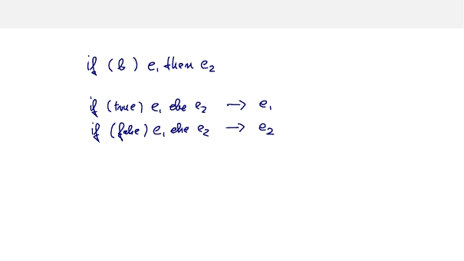
Exercise: Formulate rewrite rules for if-else

Slide 6
Value Deﬁnitions
We have seen that function parameters can be passed by value or be
passed by name.
The same distinction applies to deﬁnitions.
The def form is “by-name”, its right hand side is evaluated on each
use.
There is also a val for, which is “by-value”. Example:
val x = 2
val y = square(x)
The right-hand side of a val deﬁnition is evaluated at the point of
the deﬁnition itself.
Afterwards, the name refers to the value.
For instance, y above refers to 4, not square(2).

Slide 7
Value Deﬁnitions and Termination
The diﬀerence between val and def becomes apparent when the
right hand side does not terminate. Given
def loop: Boolean = loop
A deﬁnition
def x = loop
is OK, but a deﬁnition
val x = loop
will lead to an inﬁnite loop.

Slide 8
Exercise
Write functions and and or such that for all argument expressions x
and y:
and(x, y)
or(x, y)
==
==
x && y
x || y
(do not use || and && in your implementation)
What are good operands to test that the equalities hold?

